Slide 1
DESIGN OF STRESS DETECTOR USING MACHINE LEARNING TECHNIQUES

Slide 2


Slide 3
INTRODUCTION
Stress can be commonly interpreted as the disruption in normal psychology.
There are two kinds of stress
1.Positive Stress
2.Distress(Negative Stress)

Slide 4
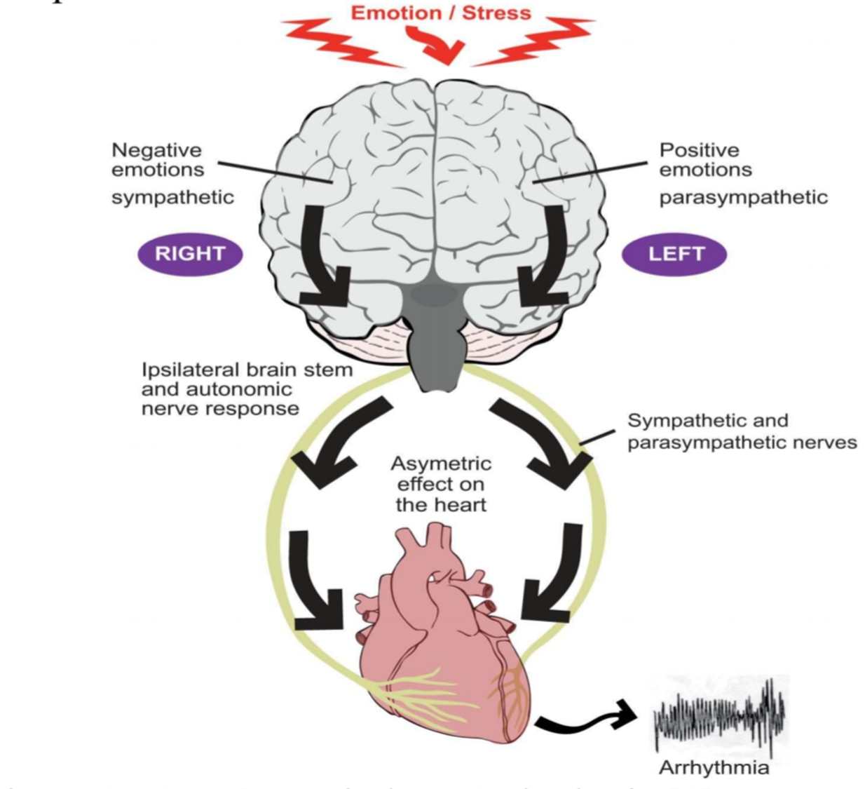

Slide 5
EFFECTS OF STRESS
Mental health disturbances.
Many physiological parameters such as pupil dilation, skin conductivity, respiration, muscle activity are affected.
Different parameters of ECG such as RR,QT,ST intervals as well as heart rate variability(HRV) are affected.

Slide 6
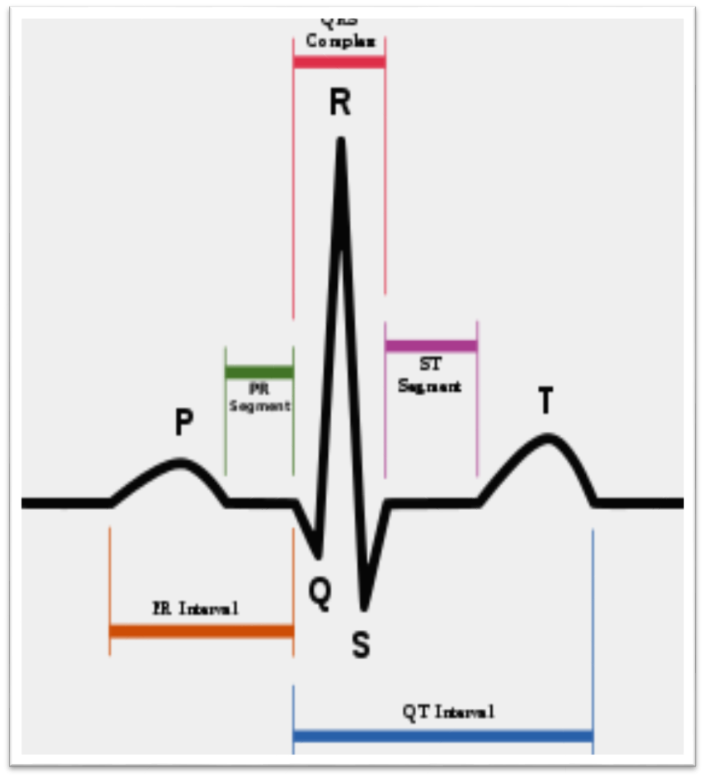
ECG SIGNAL
The ECG signal is an electrical illustration of the activity of the human heart.
ECG signal plays a vital role in emotion recognition and deviations in the normal electrical patterns indicate various features to detect the emotions.
RR,QT intervals and EDR are used for the stress detection.

Slide 7
DATA FOR MODELLING
Supervised Machine Learning has been used to detect stress.
ECG features that were chosen to detect stress are QT interval, RR interval and ECG Derived Respiration.By analyzing them, the model will decide if the subject is stressed or relaxed.
An SVM Machine is used as a classification technique.

Slide 8
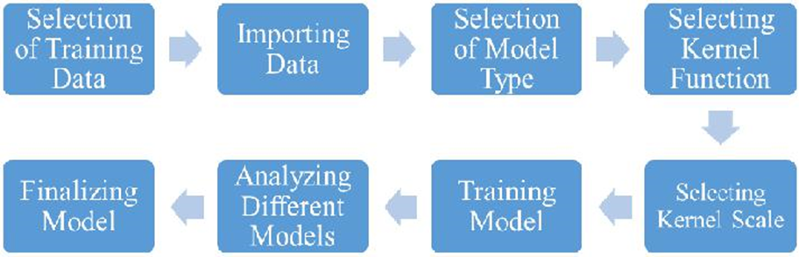
Block Diagram of SVM model anlysis

Slide 9
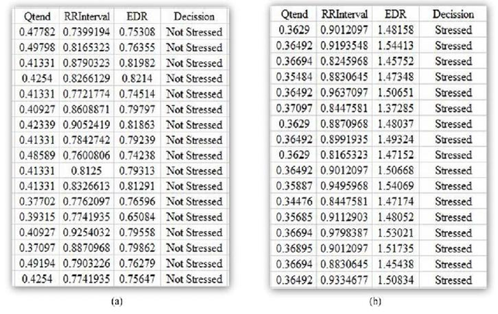

Slide 10
CONCLUSION
This method to detect stress from ECG signal can help an individual to assess one’s psychological condition as well as physical condition, from which he/she will be able to take necessary precautions. It was also concluded that, the more features(RR,QT,EDR) we use, the more accurate the model becomes.

